Slide 1
War and its Infectious Implications
بِسْمِ اللهِ الرَّحْمٰنِ الرَّحِيْمِ
Infectious Disease Surveillance
in the Context of
Conflict in Syria
by
Sammy Mehtar
UC Berkeley – UCSF
Joint Medical Program
Notes:
Exactly 8 years and 8 months ago from today (03/15/2011 - 11/15/2019)
Have one narrative: only one question.
Include other questions in the future steps slide
Maps need no titles journey is important
Confused on pyramid slide:
Cut the bullets
Emphasize that it happens every week
Build pyramid step by step
No acronyms
How to frame the incidence vs counts
Explain political maps better
Journey is good
Two stories:
The conflict and its impact
The measles
Do not be ashamed about negative findings
Hospital bombings do not predict
Daesh did predict measles
Human rights on access to health
More structural determinents
Lot more going on: this stsructural issue of access to resources (Daesh)
Hospital bombings have other impacts that may not be masured acutely, as much as Daesh.

Slide 2
2016-2018
Major Cities including Aleppo, Homs, Hama, and Ghouta Fall
2019
Turkish Offensive in north-east
2015
US Intervention, peak of rebel groups
March 15, 2011
Protests start in midst of Arab Spring
2011-2013
Conflict turns to war
Summer 2011
Violence Erupts
2014
Rise of Daesh and other foreign sponsored groups
2016
Russian, Iranian, and Turkish intervention, government resurgence
2018
Fall of Daesh, US declares withdrawal
October 30, 2019
Syrian Constitutional Committee signed government and opposition leaders

Slide 3
The Conflict in Syria
March – July 2011: Anti-government protests began in the context of the Arab Spring
July 2011 – April 2012: Initial armed insurgency
June 2012 – December 2013: Escalation of conflict
January - September 2014: Rise of Daesh and other foreign-sponsored groups, inter-rebel fighting
September 2014 – September 2015: US Intervention and peak of rebel groups
September 2015 – August 2016: Russian and Iranian intervention, resurgence of government offensives
August 2016 – January 2017: Turkish and Kurdish interventions in northern Syria
December 2016 – August 2018: Aleppo, Hama, and Ghouta recaptured, fall of Daesh
September 2018 – May 2019: US announces withdrawal, inter-rebel conflict intensifies
May 2019 – October 2019: Northern buffer zone established, Turkish offensive in north-eastern Syria
October 30, 2019: UN-backed Syrian Constitutional Committee signed by government and opposition leaders
Notes:
Lot of media attention on Turkish invasion. We only remember the tragedies that the media decides to focus on, but the war has been going on for
Exactly 8 years and 8 months ago from today (03/15/2011 - 11/15/2019)

Slide 4
The Conflict in Syria
Notes:
Lot of media attention on Turkish invasion. We only remember the tragedies that the media decides to focus on, but the war has been going on for
Exactly 8 years and 8 months ago from today (03/15/2011 - 11/15/2019)

Slide 5
The Conflict in Syria
March – July 2011: Anti-government protests began in the context of the Arab Spring

Slide 6
The Conflict in Syria
March – July 2011: Anti-government protests began in the context of the Arab Spring
July 2011 – April 2012: Initial armed insurgency

Slide 7
The Conflict in Syria
March – July 2011: Anti-government protests began in the context of the Arab Spring
July 2011 – April 2012: Initial armed insurgency
June 2012 – December 2013: Escalation of conflict

Slide 8
The Conflict in Syria
March – July 2011: Anti-government protests began in the context of the Arab Spring
July 2011 – April 2012: Initial armed insurgency
June 2012 – December 2013: Escalation of conflict
January - September 2014: Rise of Daesh and other foreign-sponsored groups, inter-rebel fighting

Slide 9
The Conflict in Syria
March – July 2011: Anti-government protests began in the context of the Arab Spring
July 2011 – April 2012: Initial armed insurgency
June 2012 – December 2013: Escalation of conflict
January - September 2014: Rise of Daesh and other foreign-sponsored groups, inter-rebel fighting
September 2014 – September 2015: US Intervention and peak of rebel groups

Slide 10
The Conflict in Syria
March – July 2011: Anti-government protests began in the context of the Arab Spring
July 2011 – April 2012: Initial armed insurgency
June 2012 – December 2013: Escalation of conflict
January - September 2014: Rise of Daesh and other foreign-sponsored groups, inter-rebel fighting
September 2014 – September 2015: US Intervention and peak of rebel groups
September 2015 – August 2016: Russian and Iranian intervention, resurgence of government offensives

Slide 11
The Conflict in Syria
March – July 2011: Anti-government protests began in the context of the Arab Spring
July 2011 – April 2012: Initial armed insurgency
June 2012 – December 2013: Escalation of conflict
January - September 2014: Rise of Daesh and other foreign-sponsored groups, inter-rebel fighting
September 2014 – September 2015: US Intervention and peak of rebel groups
September 2015 – August 2016: Russian and Iranian intervention, resurgence of government offensives
August 2016 – January 2017: Turkish and Kurdish interventions in northern Syria

Slide 12
The Conflict in Syria
March – July 2011: Anti-government protests began in the context of the Arab Spring
July 2011 – April 2012: Initial armed insurgency
June 2012 – December 2013: Escalation of conflict
January - September 2014: Rise of Daesh and other foreign-sponsored groups, inter-rebel fighting
September 2014 – September 2015: US Intervention and peak of rebel groups
September 2015 – August 2016: Russian and Iranian intervention, resurgence of government offensives
August 2016 – January 2017: Turkish and Kurdish interventions in northern Syria
December 2016 – August 2018: Aleppo, Hama, and Ghouta recaptured, fall of Daesh

Slide 13
The Conflict in Syria
March – July 2011: Anti-government protests began in the context of the Arab Spring
July 2011 – April 2012: Initial armed insurgency
June 2012 – December 2013: Escalation of conflict
January - September 2014: Rise of Daesh and other foreign-sponsored groups, inter-rebel fighting
September 2014 – September 2015: US Intervention and peak of rebel groups
September 2015 – August 2016: Russian and Iranian intervention, resurgence of government offensives
August 2016 – January 2017: Turkish and Kurdish interventions in northern Syria
December 2016 – August 2018: Aleppo, Hama, and Ghouta recaptured, fall of Daesh
September 2018 – May 2019: US announces withdrawal, inter-rebel conflict intensifies

Slide 14
The Conflict in Syria
March – July 2011: Anti-government protests began in the context of the Arab Spring
July 2011 – April 2012: Initial armed insurgency
June 2012 – December 2013: Escalation of conflict
January - September 2014: Rise of Daesh and other foreign-sponsored groups, inter-rebel fighting
September 2014 – September 2015: US Intervention and peak of rebel groups
September 2015 – August 2016: Russian and Iranian intervention, resurgence of government offensives
August 2016 – January 2017: Turkish and Kurdish interventions in northern Syria
December 2016 – August 2018: Aleppo, Hama, and Ghouta recaptured, fall of Daesh
September 2018 – May 2019: US announces withdrawal, inter-rebel conflict intensifies
May 2019 – October 2019: Northern buffer zone established, Turkish offensive in north-eastern Syria

Slide 15
The Conflict in Syria
March – July 2011: Anti-government protests began in the context of the Arab Spring
July 2011 – April 2012: Initial armed insurgency
June 2012 – December 2013: Escalation of conflict
January - September 2014: Rise of Daesh and other foreign-sponsored groups, inter-rebel fighting
September 2014 – September 2015: US Intervention and peak of rebel groups
September 2015 – August 2016: Russian and Iranian intervention, resurgence of government offensives
August 2016 – January 2017: Turkish and Kurdish interventions in northern Syria
December 2016 – August 2018: Aleppo, Hama, and Ghouta recaptured, fall of Daesh
September 2018 – May 2019: US announces withdrawal, inter-rebel conflict intensifies
May 2019 – October 2019: Northern buffer zone established, Turkish offensive in north-eastern Syria
October 30, 2019: UN-backed Syrian Constitutional Committee signed by government and opposition leaders
Notes:
Lot of media attention on Turkish invasion. We only remember the tragedies that the media decides to focus on, but the war has been going on for
Exactly 8 years and 8 months ago from today (03/15/2011 - 11/15/2019)

Slide 16
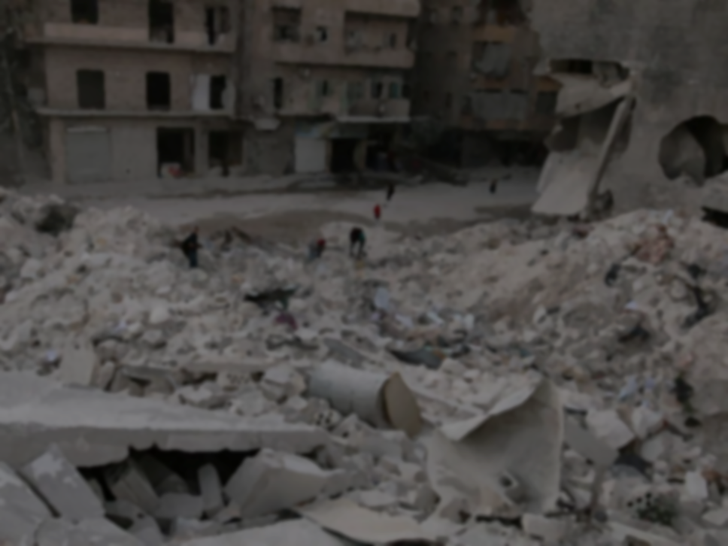
The Conflict in Syria
Conflict has become a global proxy war with civilians caught in the crossfire
Death toll.………………………………………….Immense
Refugees…………………………………………….5.6 million… and counting
Internally Displaced Persons……………………6.6 million… and counting
Prewar Population………………………………....22 million
Current Population Estimates…………………....18 million
(There are no agreed upon estimates)
12.2 Million Displaced
Sources:
Syrian Observatory for Human Rights
UNHCR
CIA WorldFactbook
Notes:
What is the relationship between conflict and healthcare?
(55.5% of prewar population displaced)

Slide 17
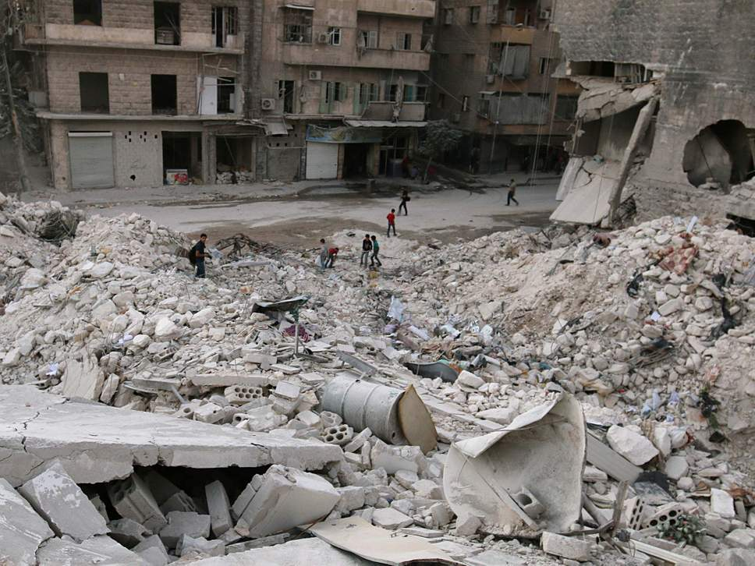
Omar ibn Abdul Aziz Hospital (AKA M2) in Aleppo, Syria
Al-Jazeera
Notes:
What is the relationship between conflict and healthcare?
How did we get here?

Slide 18
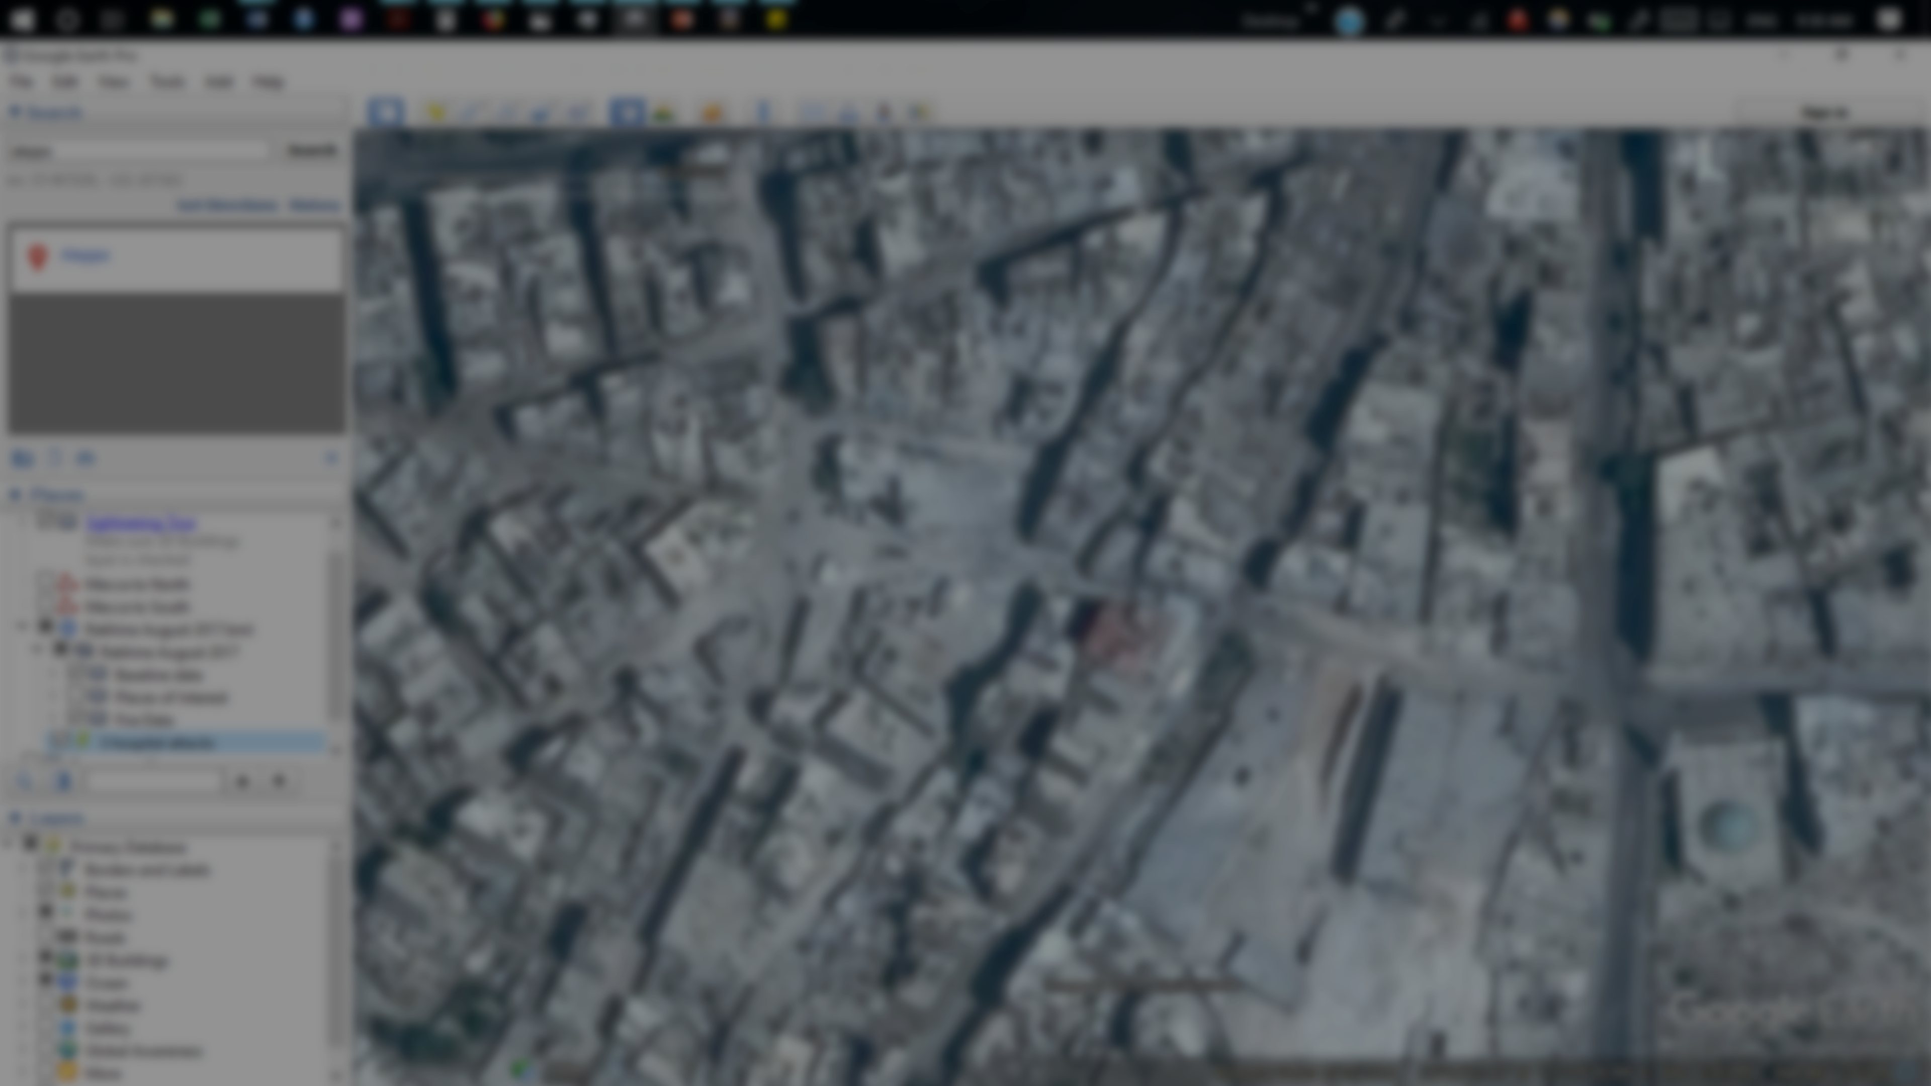
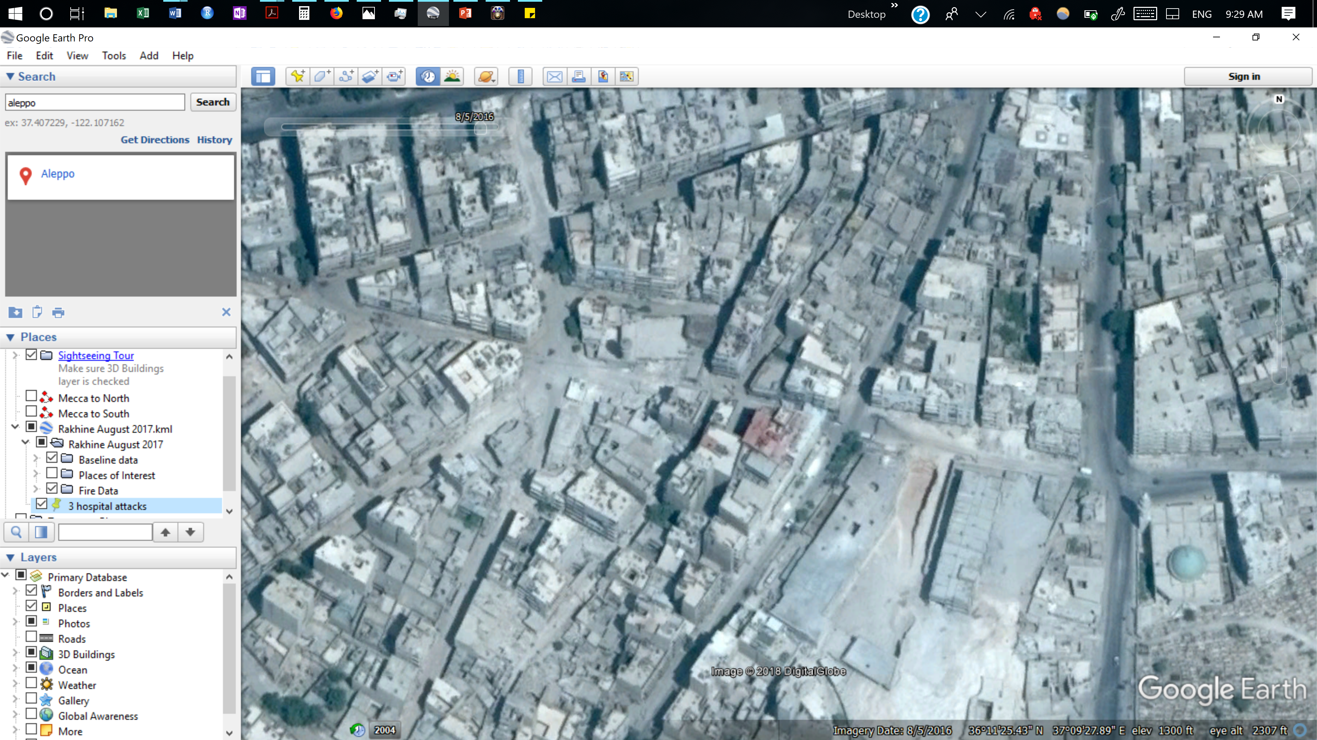
M2: 8/5/2016

Slide 19
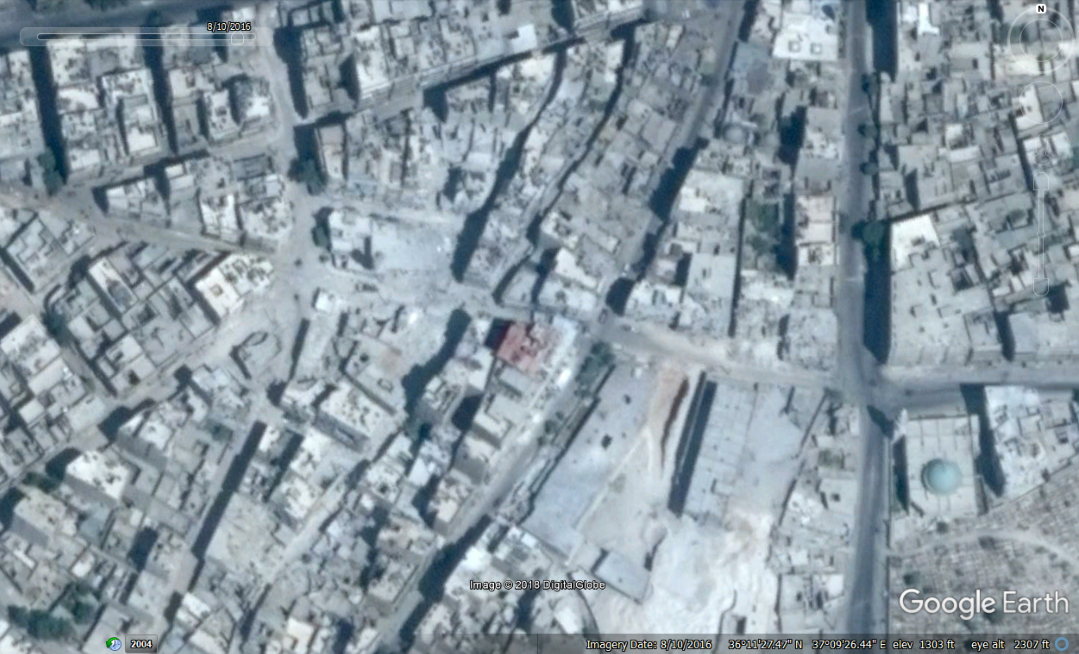
M2: 8/10/2016

Slide 20
M2: 8/10/2016

Slide 21
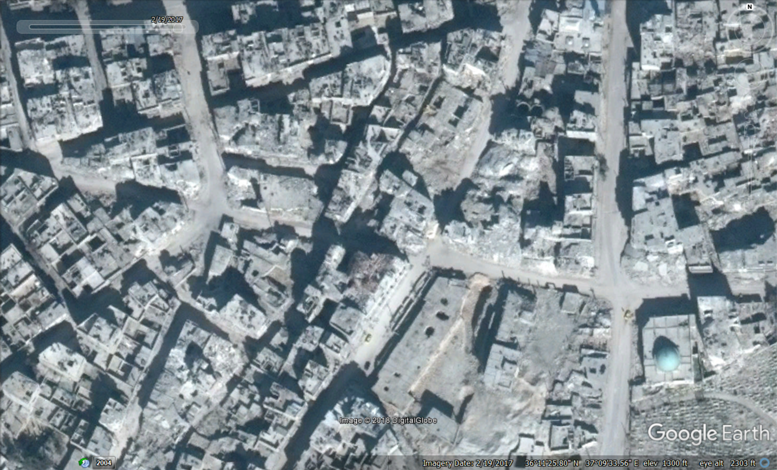
3 June 2016
14 June 2016
14 July 2016
16 July 2016
1 August 2016
5 August 2016
11 August 2016
23 September 2016
26 September 2016
28 September 2016
18 November 2016
4 December 2016
14 December 2016
M2: 2/19/2017
Notes:
Attacked 14 times in 6 months

Slide 22
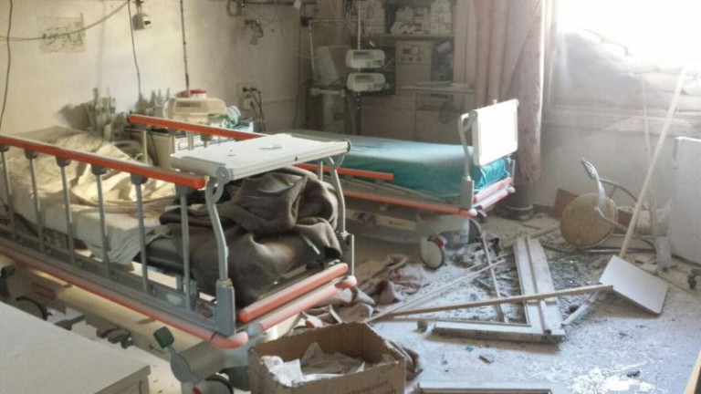
Courtesy of Union of Medical and Relief Organizations
According to SAMS: 14 Strikes from June to December 2016
Notes:
Need to rebuild: takes time, costs $$$, lost trust.
This is not just a loss of in-patient services, but of basic preventative needs like vaccinations

Slide 23
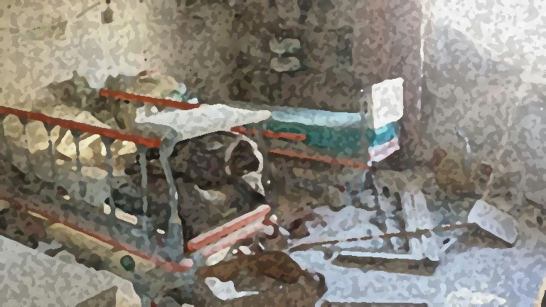
Number of verified attacks…………………………550
Number of facilities targeted…………………348
Health-workers killed………………………………891
Doctors: 32%
Nurses: 23%
Medics: 19%
medical students and other Health Professionals: 9%
Causes of Fatalities:
Shelling and bombing: 54%
Small arms fire: 21%
Torture: 13%
Execution: 7%
Verified Attacks
on Healthcare Facilities
March 2011 – December 2018
Notes:
Attacks on healthcare can include providers, facilities, equipment, medical supply chains, transportation.
Here, we are limiting the scope to facilities.

Slide 24
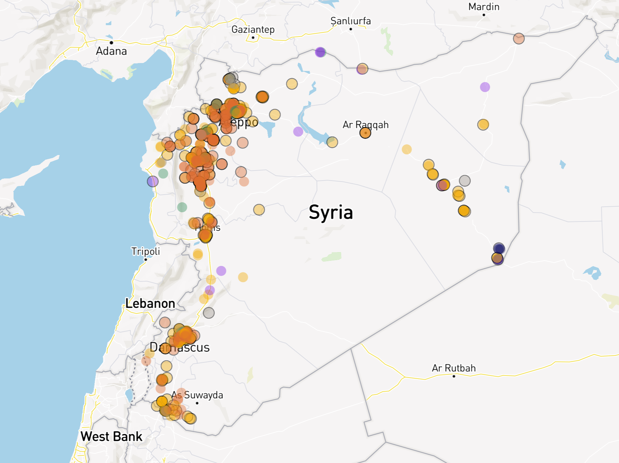
Verified Attacks
on Healthcare Facilities
March 2011 – December 2018
Source:
Physicians for Human Rights
Notes:
(Test if it works better just here or both here and below)
-> Make it fit

Slide 25
How has the Syrian Conflict shaped the epidemiology of measles
in northern Syria
between
January 2015 - June 2019?

Slide 26
Why Measles?
High number of cases
Well-suited for clinical diagnoses
Baseline: considered eliminated in Syria since 1999
One of the most infectious disease known
Sentinel disease: sensitive to drops in vaccination rate
Notes:
-> # of total measles
-> relate it to US/north American/Europe outbreaks, small gaps here lead to outbreaks

Slide 27
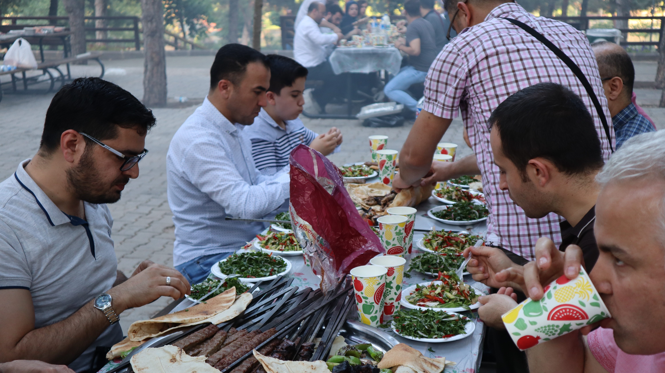
Notes:
One of the perks of staying in Turkey
Take their bbq very seriously
Beautiful views, great food, great company

Slide 28

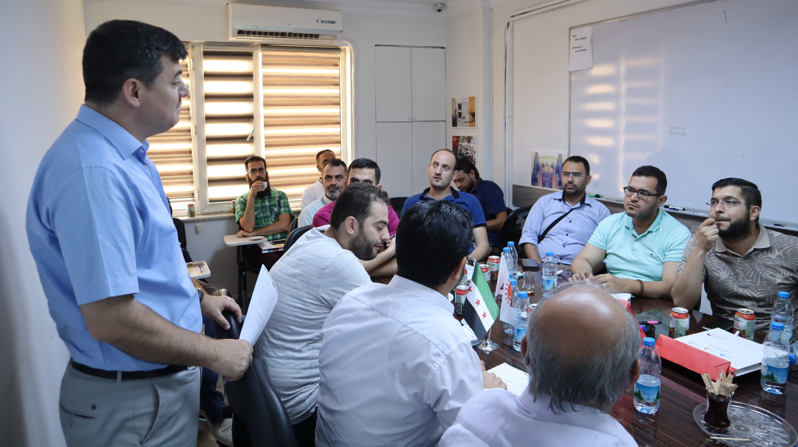
Training at the Assistance Coordination Unit (ACU), Gaziantep, Turkey
Notes:
And familiar scenes: PBL with the ever-present Turkish Tea
Worked with the ACU, which has a branch that operates an infectious disease surveillance program.

Slide 29

Structure of Surveillance
Notes:
Follow an example of 10 cases of measles.

Slide 30
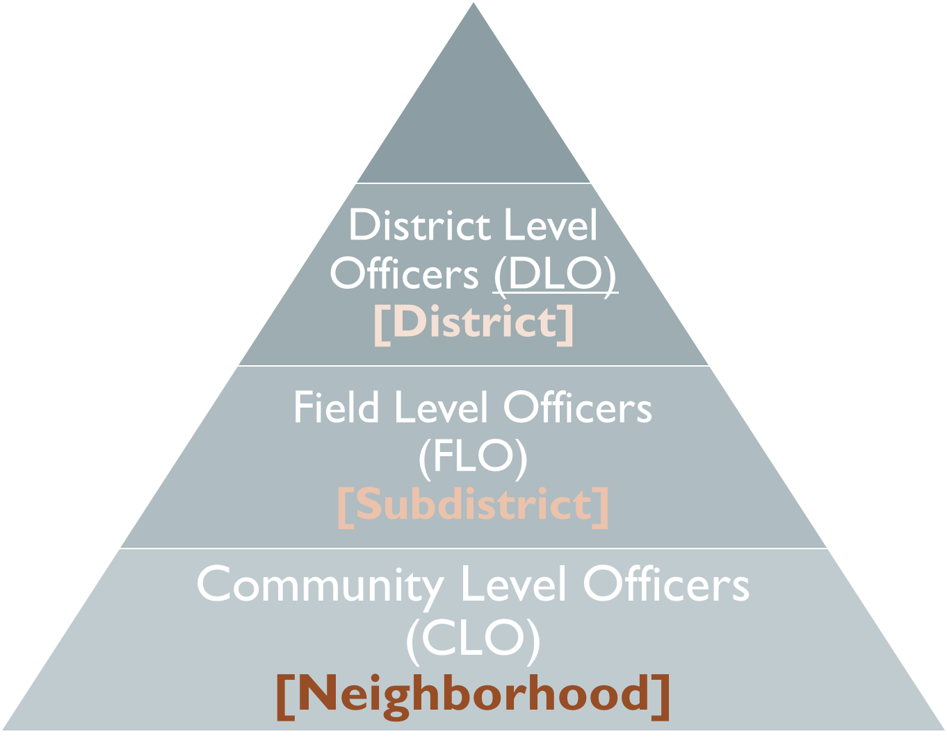
Structure of Surveillance
Notes:
-Compete until end of 2018
-UN Office for the Coordination of Humanitarian Affairs
Active surveillance with zero-reporting
Started in 2013 in aftermath of the first polio (WPV-1) outbreak
Consistent and reliable weekly data flow from 2015 - Present
Dataset includes January 2015 – June 2018 (for now)
Population data from HNAP
Healthcare infrastructure attack data from Physicians for Human Rights (PHR)

Slide 31
Structure of Surveillance
Notes:
-Compete until end of 2018
-UN Office for the Coordination of Humanitarian Affairs
Active surveillance with zero-reporting
Started in 2013 in aftermath of the first polio (WPV-1) outbreak
Consistent and reliable weekly data flow from 2015 - Present
Dataset includes January 2015 – June 2018 (for now)
Population data from HNAP
Healthcare infrastructure attack data from Physicians for Human Rights (PHR)

Slide 32
Structure of Surveillance
Notes:
-Compete until end of 2018
-UN Office for the Coordination of Humanitarian Affairs
Active surveillance with zero-reporting
Started in 2013 in aftermath of the first polio (WPV-1) outbreak
Consistent and reliable weekly data flow from 2015 - Present
Dataset includes January 2015 – June 2018 (for now)
Population data from HNAP
Healthcare infrastructure attack data from Physicians for Human Rights (PHR)

Slide 33
Structure of Surveillance
Notes:
-Compete until end of 2018
-UN Office for the Coordination of Humanitarian Affairs
Active surveillance with zero-reporting
Started in 2013 in aftermath of the first polio (WPV-1) outbreak
Consistent and reliable weekly data flow from 2015 - Present
Dataset includes January 2015 – June 2018 (for now)
Population data from HNAP
Healthcare infrastructure attack data from Physicians for Human Rights (PHR)

Slide 34
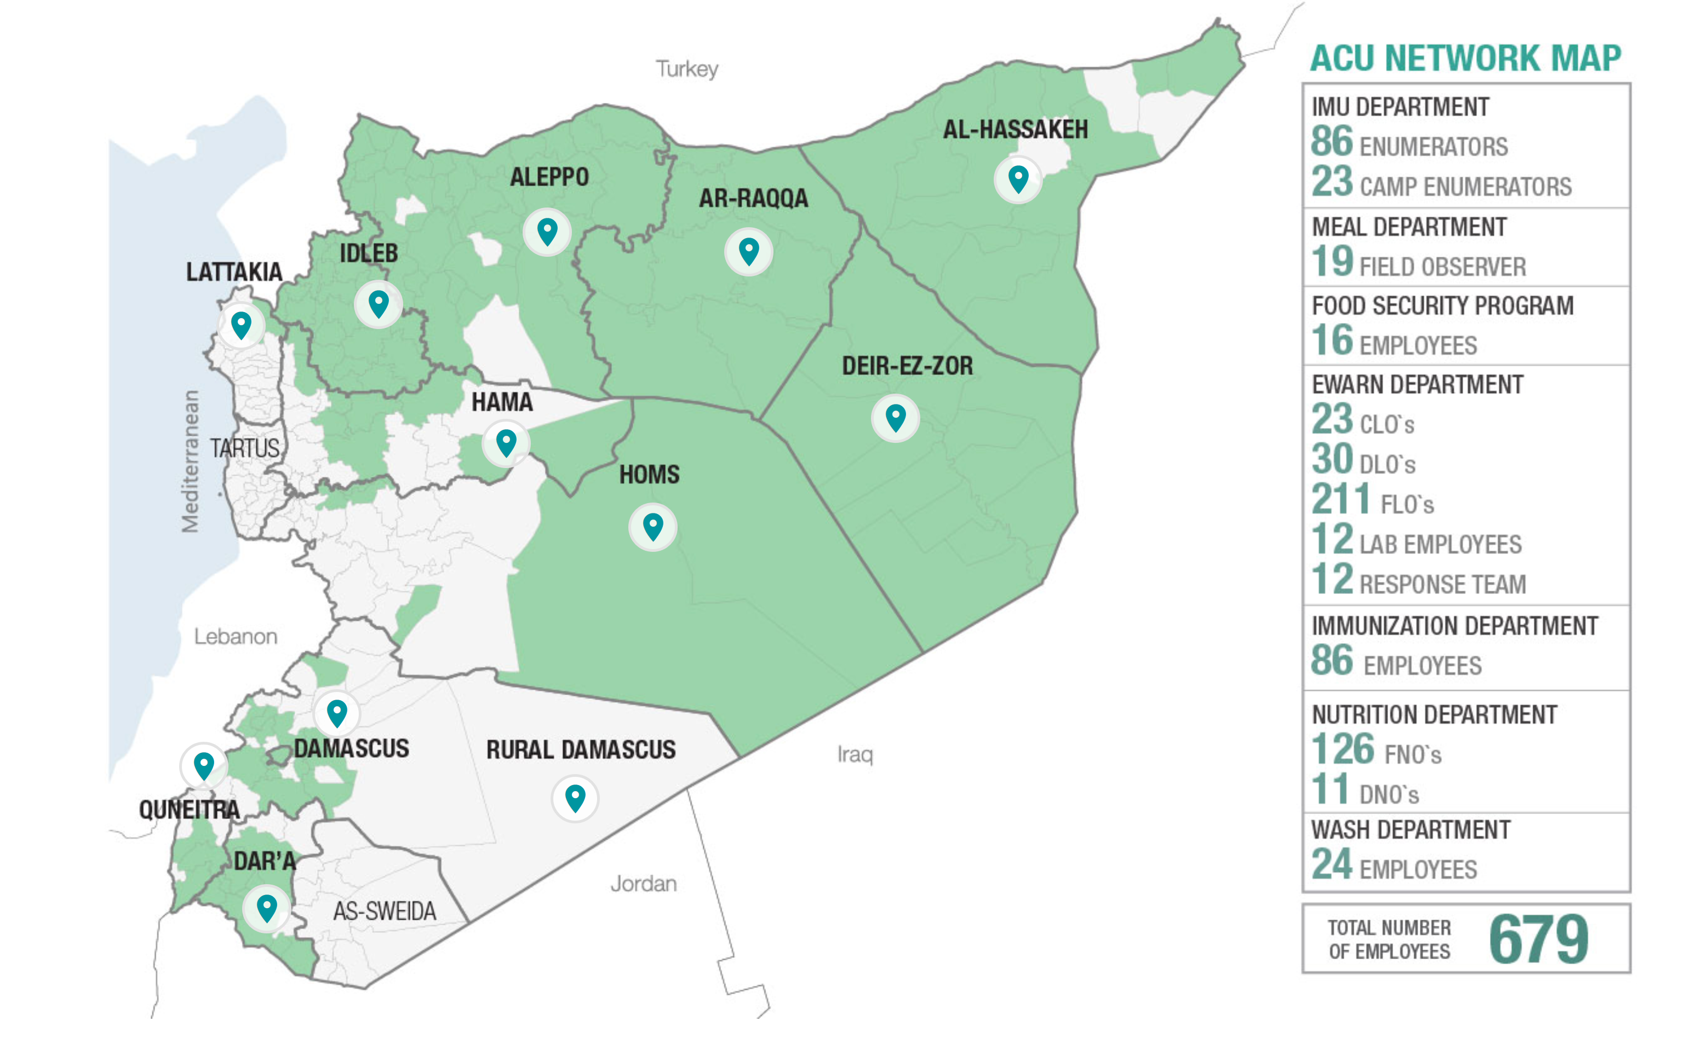
Coverage Map: Maximum Extent
x
x
x
x
Notes:
This is where the data captured in our dataset comes from
Since then, the ACU has lost access to many regions, since they operate in opposition controlled territories

Slide 35
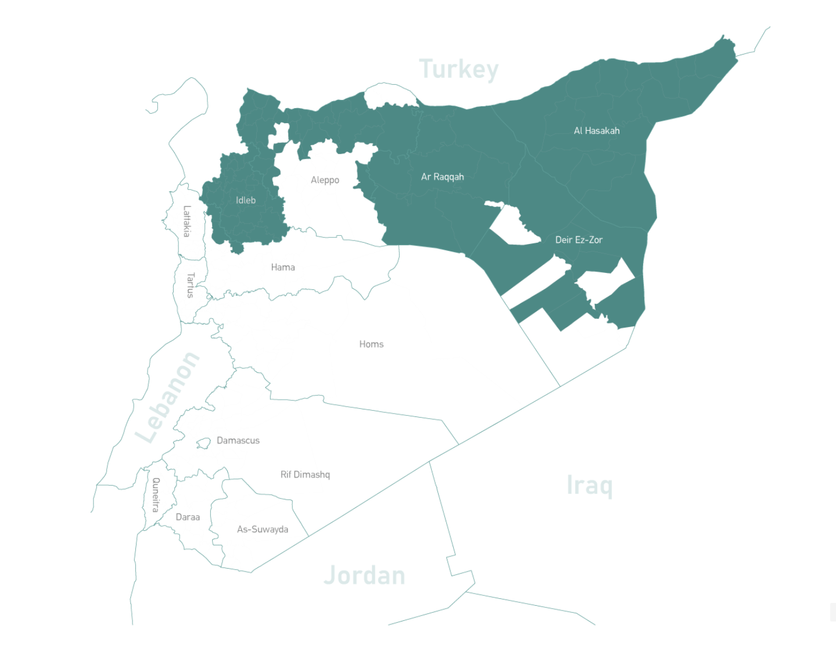
Coverage Map: 2019

Slide 36
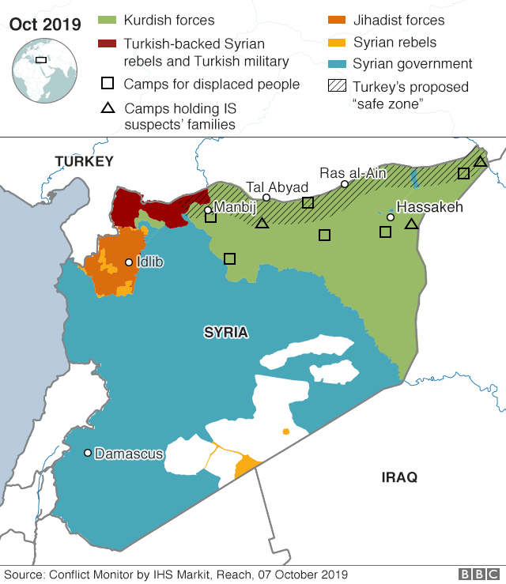
Notes:
The map now (April 2019). Syrian and Russian forces have gained the bulk of lost territory over the last year.
Red: Syrian government and its allies
Green: Syrian Opposition and its allies
Yellow: Democratic Federation of Norther Syria
-> clarify Turkish situation more recently
-> “popular in the media” but

Slide 37
ACU Surveillance Dataset
Cases of 14 infectious disease syndromes
4.5 years of weekly reports between January 1st, 2015 and June 30, 2019
Stratified by sex (Female vs. Male) and age (≥5 vs. <5)
Stratified by governorate, district, and subdistrict
Population of districts between 2015-2019
Collected monthly by the Humanitarian Needs Assessment Program (HNAP)
Attacks on healthcare facilities 2011 - 2018
Collected and verified by Physicians for Human Rights
Stratified by district, method of attack, and alleged perpetrator of attack
– Including Measles
Notes:
-> Focus on your dataset.
-> say that this is broader dataset

Slide 38
Our Study
Cases of Measles
4.5 years of weekly reports between January 1st, 2015 and June 30, 2019
Stratified by sex (Female vs. Male) and age (≥5 vs. <5)
Stratified by governorate, district, and subdistrict
Population of districts between 2015-2019
Collected monthly by the Humanitarian Needs Assessment Program (HNAP)
Attacks on healthcare facilities 2011 - 2018
Collected and verified by Physicians for Human Rights
Stratified by district, method of attack, and alleged perpetrator of attack
Notes:
-> Focus on your dataset.
-> say that this is broader dataset

Slide 39
Measles
30,241
Patient presentation consistent with measles criteria
>5 cases / district / month
2/3 of clinically suspected cases that are tested are confirmed
Total number of clinically suspected cases between
January 2015 – June 2019
Clinically suspected:
Outbreak threshold:
Lab confirmation:
Notes:
samples collected from affected communities during outbreaks to confirm diagnoses

Slide 42
Governorate

Slide 43
District

Slide 44
Subdistrict

Slide 45
Weekly Incidence of Measles by Governorate January 2015 – June 2019
Notes:
-> what do you want the audience to get from it
Syria had a very strong vaccination program prior to the conflict
Pre-war incidence was very low, no autochthonous cases or outbreaks since 1999
What we see here is that although there were minor outbreaks in the first couple years of the our data collection, we see massive spikes in incidence in 2017 and 2018

Slide 46
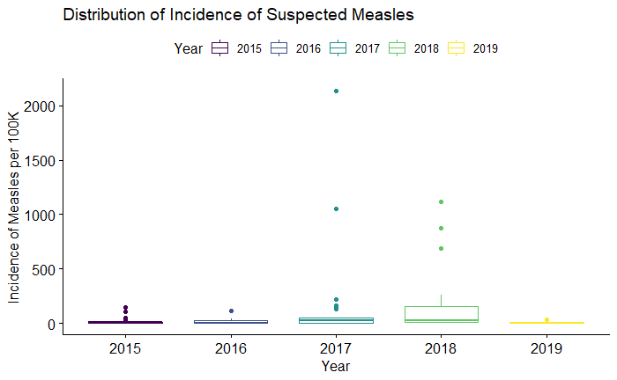
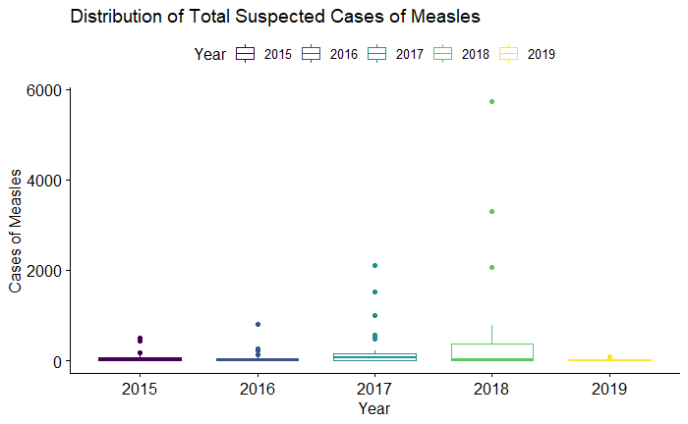
Suspected Annual
Incidence of Measles
by Year
Suspected Annual
Absolute Number of Cases of Measles
by Year
Notes:
Each dot represents a district.
Incidence represents the number of cases per 100,000 people each year.
Before we saw spikes in incidence between governorates, but within governorates there are large differences.
Even though many districts had higher levels of incidence in 2017 than in 2018, the total number of cases was actually higher in 2018 because the outbreaks were in more populated regions.
The bottom chart shows us which districts were most effected, and when: each bar represents the total number of cases in a given year.
-> describe low incidence to high incidence, absolute vs incidence
-> need oneliner on the difference between incidence and absolute cases
-> thing point about children

Slide 47
Show me the Stats:
Results from Pairwise
Wilcoxon Rank-Sum Test
Governorate | Al- Hasakeh | Aleppo | Ar-Raqqa | Dar’a | Deir-ez-Zor | Hama | Homs | Idleb
Aleppo | <0.001 | - | - | - | - | - | - | -
Ar-Raqqa | <0.001 | <0.001 | - | - | - | - | - | -
Dar’a | 0.068 | <0.001 | <0.001 | - | - | - | - | -
Deir-ez-Zor | <0.001 | <0.001 | <0.001 | <0.001 | - | - | - | -
Hama | <0.001 | <0.001 | <0.001 | <0.001 | <0.001 | - | - | -
Homs | <0.001 | <0.001 | <0.001 | <0.001 | <0.001 | <0.001 | - | -
Idleb | <0.001 | 0.018 | 0.018 | <0.001 | <0.001 | <0.001 | <0.001 | -
Quneitra | 0.29 | <0.001 | <0.001 | 0.037 | <0.001 | <0.001 | <0.001 | <0.001
P-values from the pairwise Wilcoxon rank-sum tests
Significance level: ≤ 0.05
Null hypothesis: Median difference between pairs of governorates is 0
Notes:
Salmon color: Outbreaks in 2017 or 2018
Non-parametric data: not normally distributed.
For the Wilcoxon test, a p-value is the probability of getting a test statistic as large or larger assuming both distributions are the same
“does not estimate the difference in medians (a common misconception) but rather the median of the difference between a sample from x and a sample from y.”

Slide 48
Annual Incidence
of Suspected Measles in Syria
District Level
Annual Incidence
(per 100,000)
2017
2018
Notes:
This is all coming from context of war
Areas under government control have, for the most part, retained some access to public health services and surveillance.
What’s crazy about this is that this was a grassroots effort by Syrian physicians, that garnered support from international organizations such as the WHO, B&MGF, and even the CDC, and has produced data that, as one study showed, is likely more accurate than estimates from the governmental surveillance efforts.
Challenges what is possible to study in conflict, and the very reliability of information in a war torn setting, all that in a conflict that has been plagued by misinformation and propaganda.

Slide 49
Annual Incidence
of Suspected Measles in Syria
Subdistrict Level
Annual Incidence
(per 100,000)
2017
2018
Notes:
This is all coming from context of war
Areas under government control have, for the most part, retained some access to public health services and surveillance.
What’s crazy about this is that this was a grassroots effort by Syrian physicians, that garnered support from international organizations such as the WHO, B&MGF, and even the CDC, and has produced data that, as one study showed, is likely more accurate than estimates from the governmental surveillance efforts.
Challenges what is possible to study in conflict, and the very reliability of information in a war torn setting, all that in a conflict that has been plagued by misinformation and propaganda.

Slide 50
Total Number of Cases
of Suspected Measles
January 2015 – June 2019
Notes:
Why don’t we see outbreaks in 2

Slide 51
Verified Attacks
on Healthcare Facilities
March 2011 – December 2018

Slide 52
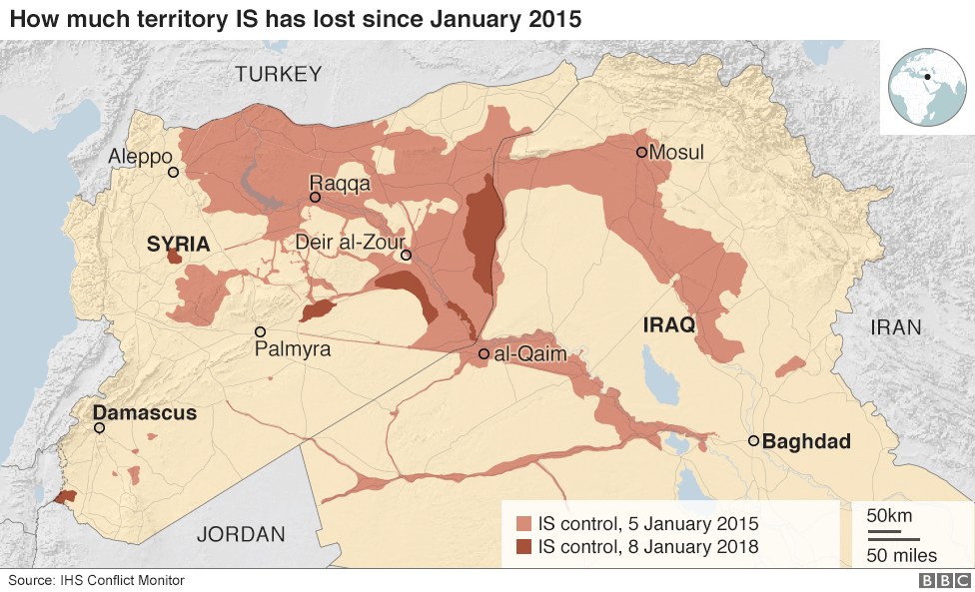
Territory Held By Daesh
January 2015 vs. January 2018
Notes:
Not just Daesh control, but also targeting of Daesh.
Many Russian, American, Iranian, and even French airstrikes in this region, especially in Ar-Raqqa and Deir-ez-Zor, where we saw the outbreaks.
Is this a function of limited access due to Daesh?
Or of targeting these regions by foreign militaries?
Both?
We cannot draw conclusions, but what we can say for certain is that such severe targeting has led to drops in vaccination rates and the major outbreaks we saw in 2017 and 2018.

Slide 53
Challenges & Limitations
Not all cases of measles present to a clinical setting
“Attacks” limited to attacks on facilities
No assessment of sensitivity of clinical findings
Difficult to disentangle other effects of conflict on public health
Impact of conflict on integrity of data collection
Limited access to many regions
Dynamic population

Slide 54
Strengths
Unique:
No published literature that incorporates such rich data across all of these years of the conflict
One of the best documented conflicts in human history
Potential to contribute to models for surveillance and research in conflict
Necessary:
Potential Implications
Notes:
I would argue that this line of inquiry is both unique and necessary

Slide 55
Potential Implications
Hypothesis Generation
Associations between attacks on healthcare or other major milestones of the conflict and infectious disease trends can guide us to target future research
Programmatic Guidance
Building our understanding of potential impacts on infectious diseases can help us preemptively respond in future crises
Understanding regional vulnerability to vaccine preventable diseases or waterborne illnesses can help inform future vaccination campaigns or sanitation projects
Advocacy
Documenting public health effects of conflict is critical for accountability
Maintain awareness of the broader and long-term impact that war and war crimes can have
Empower local NGOs and support their crucial efforts
Notes:
Hypothesis Generation
Associations between attacks on healthcare or other major milestones of the conflict and infectious disease trends can guide us to target future research
Programmatic Guidance
Building our understanding of potential impacts on infectious diseases can help us preemptively respond in future crises
Understanding regional vulnerability to vaccine preventable diseases or waterborne illnesses can help inform future vaccination campaigns or sanitation projects
Advocacy
Documenting public health effects of conflict is critical for accountability
Maintain awareness of the broader and long-term impact that war and war crimes can have
Empower local NGOs and support their crucial efforts

Slide 56










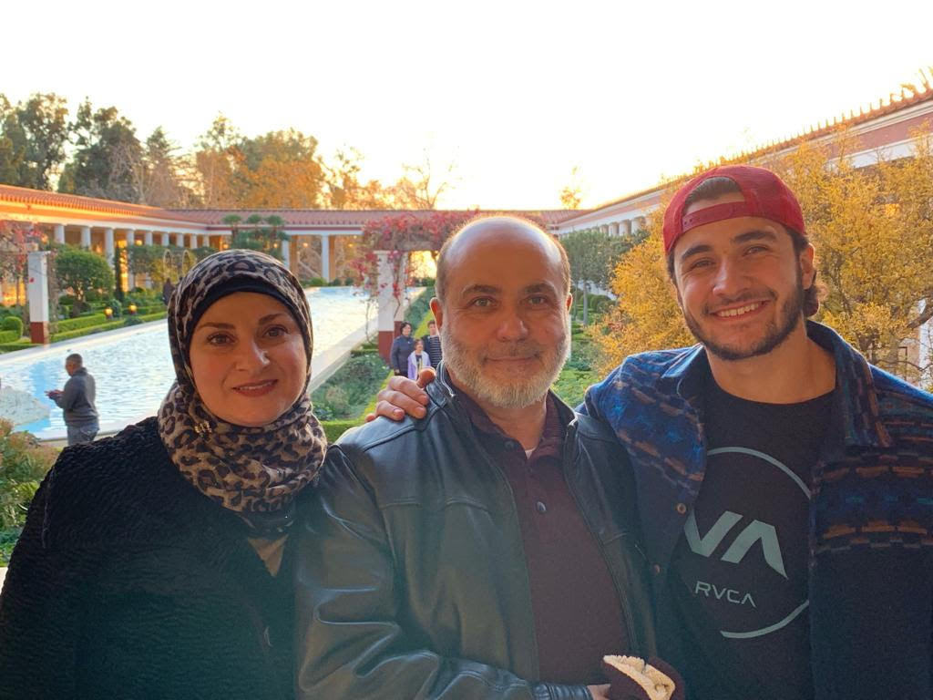
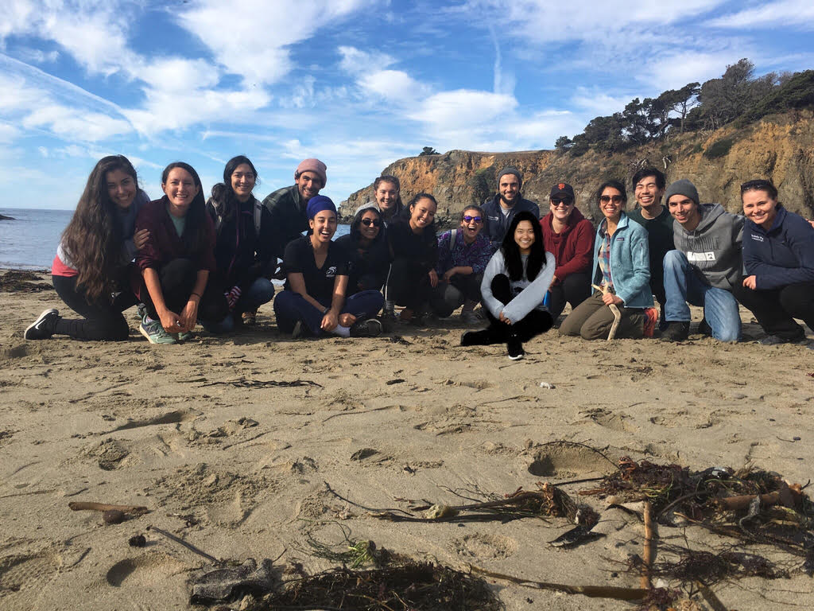
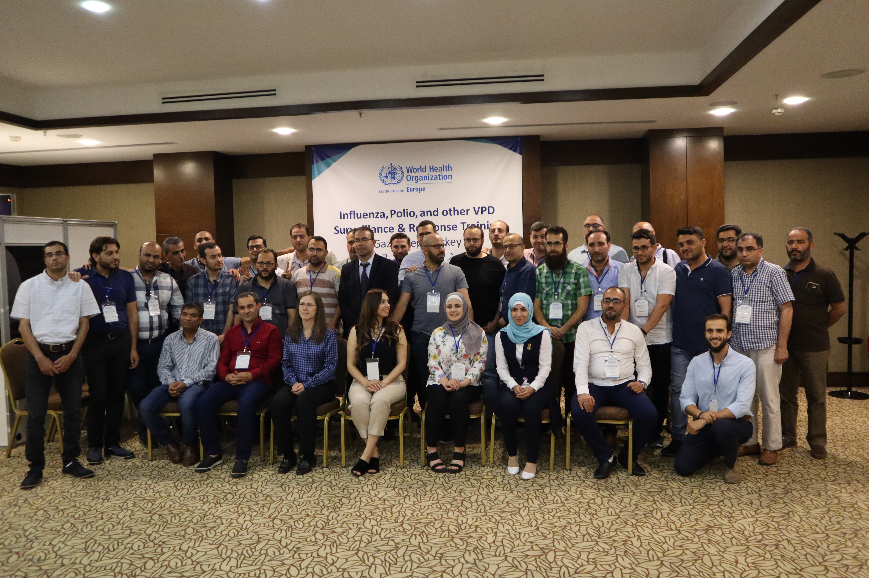
Special Thanks
Dr. Rohini Haar
Dr. Arthur Reingold
Dr. Ndola Prata
My Family
My Friends
The Unrecognized Heroes on the Ground

Slide 57

شكراً
Thank You
Notes:
Talk more about thesis:
What data do you have
What do you plan to do with the data
What are future implications of the data
How future people can benefit
Ended where I should start.
Start with what your ultimate goal is, and what your variables are, tell them why you’re going to all this info
Comparing model against other wars without conflict, comparing baseline to other countries average or to Syria’s baseline
Focus less on limitations, more positive spin: despite limitations, here are our contributions. Unique opportunity.
A general outline of WIPs (but only if this fits your topic) would be:
Title slide with your name and your affiliation (JMP)
Acknowledgements slide (at the beginning OR at the end—this should be BRIEF and reasonable. Your kindergarten teacher probably DOES deserve credit, but probably not today)
(Outline of talk)—Only if you have an overview that really describes your talk, not a list of the sections below!!
Background—This will be an important part of your talk at this stage. It should lead directly to “e” below.
Research question or area of interest (if RQ not appropriate)
(Hypotheses)—if applicable
Methods:
Sampling and recruitment
Variables
Data collection
Analysis
Preliminary Results—IF APPLICABLE
Limitations (what are the weaknesses of the research, particularly those that may have biased the findings)
Timeline and next steps
Lessons learned (for the 1st years, also optional)
Questions for the audience (optional)

